Slide 1



Street-Level Imagery Analysis : HOTOSM
Final Presentation
Automating the detection and classification of geospatial features like buildings, solar panels, and rooftop materials to enhance decision-making for humanitarian and climate actions.
Date: 30/04/2025
Notes:
- let people in!
- make partner co-host
- Record
- welcome and congratulate folks for being selected
- Before we start, I want to let you know that call is being recorded for internal Omdena use and will not be shared
So let’s start with the outline of this call. We will aim to keep it within 1.5 hour

Slide 2
Objective
Development of AI tool to develop a proof of concept (POC) that demonstrates the capability to Automate the detection and classification of geospatial features like buildings, solar panels, and rooftop materials to enhance decision-making for humanitarian and climate actions.
Use Case:
Street-level imagery offers a wealth of information that can aid urban planners, policymakers, and disaster response teams. However, manually analyzing such data is time-intensive, prone to errors, and challenging to scale. Automating this process can improve the precision, efficiency, and consistency of insights generated from street-level imagery.

Slide 3
Goal of the projects
1. CLASSIFY ROAD CONDITIONS FOR MAINTENANCE PLANNING
Paved/Not Paved
2. Segmenting Building material for reconstruction
Material - Wood,plastic,cement,metal etc.

Slide 4

TIMELINE OF THE PROJECT
Week 0
Feb. 16, 2025
Week 1
Feb. 23, 2025
Week 2
March 2. , 2025
Week 3
March 9 , 2025
Week 4
Mar 16. , 2025
Week 5
Mar.23 , 2025
Week 6
Mar 30. , 2025
Week 7
Mar. , 2025
Week 30
Apr. , 2025
CELEBRATE!!
FINAL PRESENTATION

Slide 5

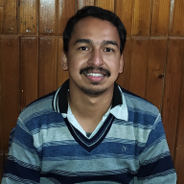


Diverse and Global Omdena Community
60+ collaborators across diverse time zones (Diversity!)
From all over the world New collaborators Omdena community members (Jr. and Lead ML engineers)
Narayan S. Adhikari
TSOGTSAIKHAN BATDELGER
RASHA SALIM
Product Manager
Innovation Project Lead
CPO

Slide 6
Tasks & Leads
TASK # | TASK LEADERS
TASK 0: Data Collection | Shiv Saxena
TASK 1: Preprocessing | Serge Scevenels
TASK 3: Model Building | Suraj Karki, Arudhra
TASK 4: Documentation | Makena,Nelkon
Around 15 active collaborators

Slide 7
We have made good progress towards collecting and annotating data
Technical Progress
Data Collection
Preparation & Training
Labelling
Completed annotation of all images (1,000) using a multi-annotator approach (minimum two annotators per image).
Implemented a review process: All annotations reviewed by a designated expert.
Achieved the following label distribution:
Roads: 60% Paved, 40% Unpaved.
Buildings: 51% Masonry, 37% Metal, remaining categories at 4-5% each.
Exceeded initial image collection target, gathering over 6,000 images of roads and building materials across diverse regions in Kenya.
Successfully pre-processed and filtered a subset of 1,000 images suitable for annotation.
Developed a comprehensive labeling ontology for consistent annotation.
Uploaded 1,000 pre-processed images to Labelbox.
Conducted a training workshop on the ontology and Labelbox annotation tools.

Slide 8
We have made good progress towards collecting and annotating data
Technical Progress
Preparation & Training
Labelling
Model Building
Trained various Models for road classification and building material segmentation.

Slide 9
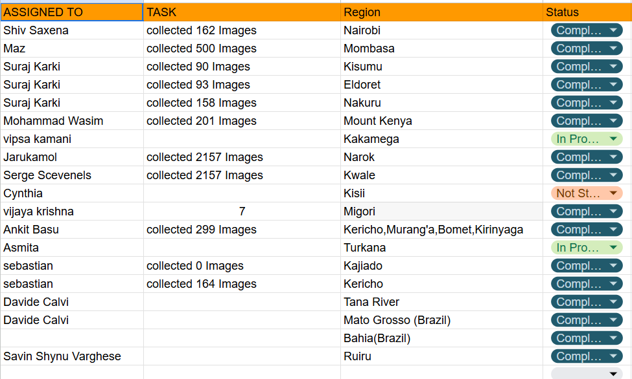
Task 1: Data Collection
Collected around 6k images for 16 out of 47 regions of Kenya

Slide 10
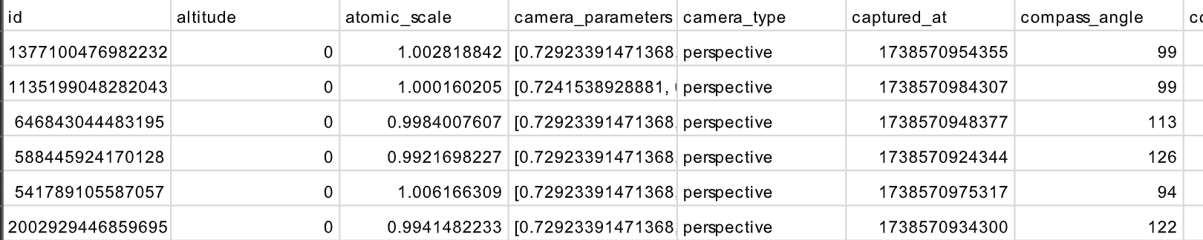
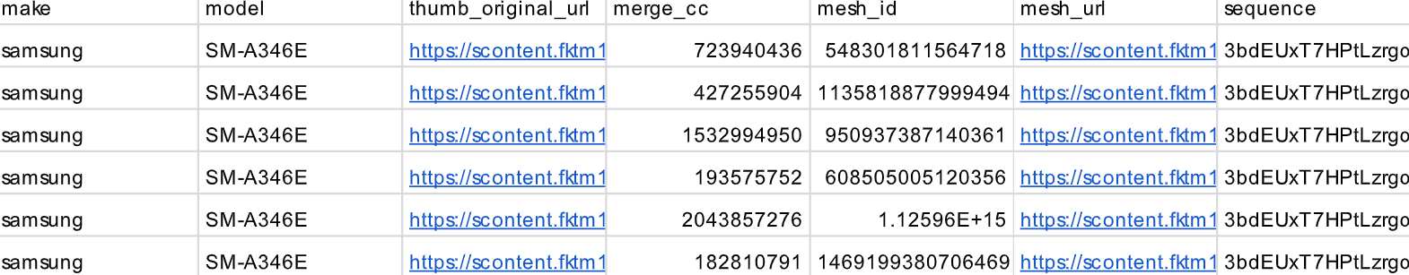
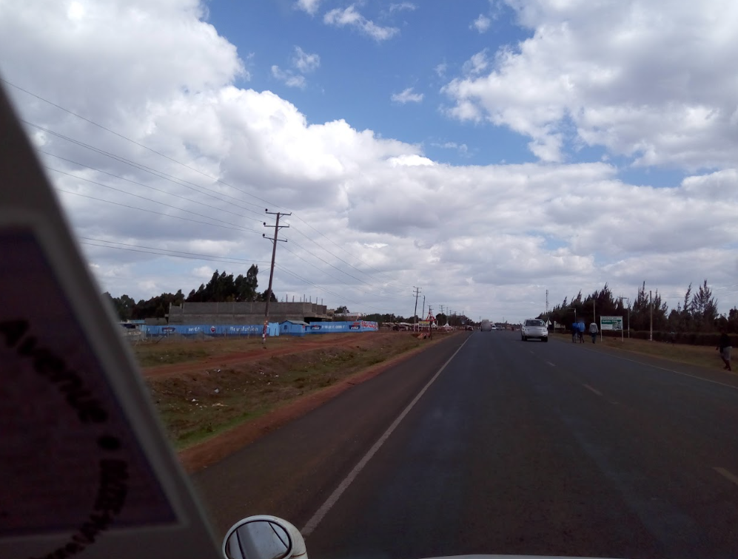
Task 1: Data Collection
Images are saved in the google drive- data folder.
Each downloaded instance contains images as well as metadata.

Slide 11
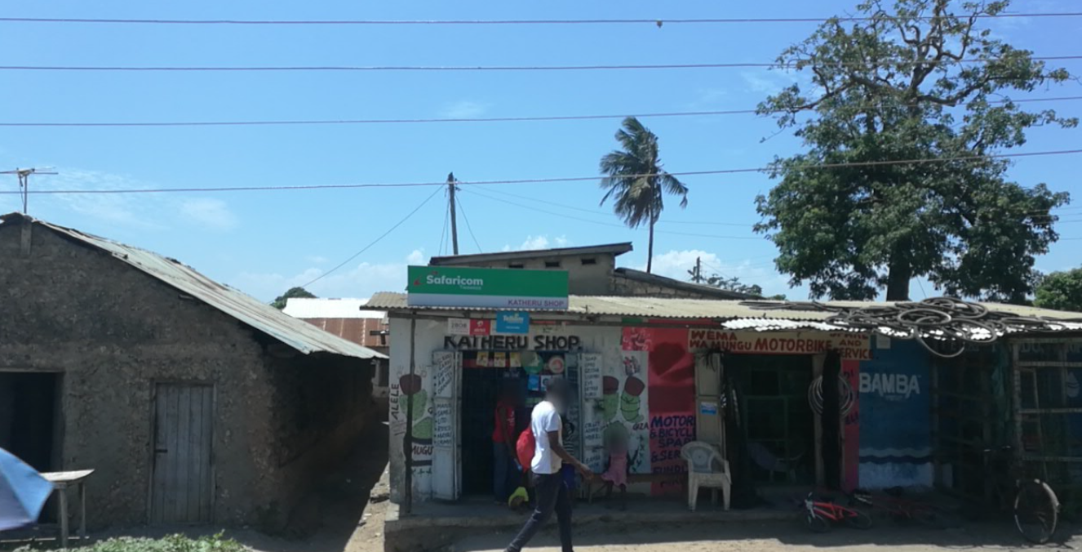
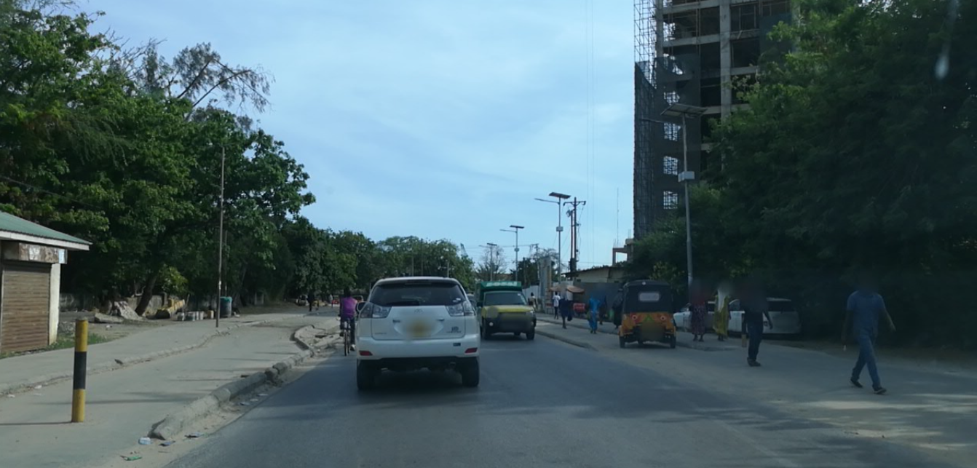

Slide 12
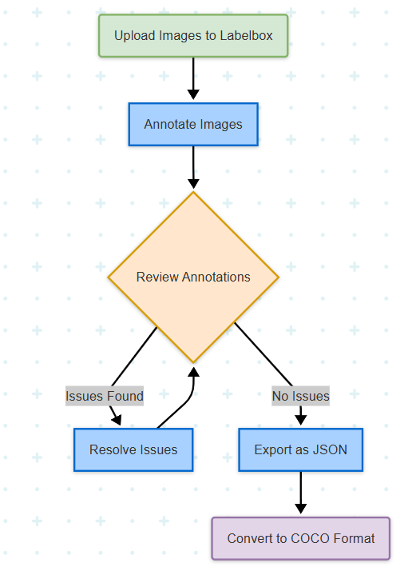
Task 2: Labeling and Preprocessing

Slide 13
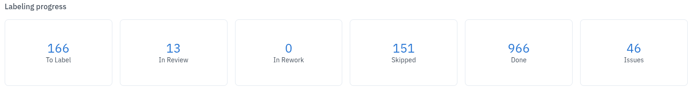
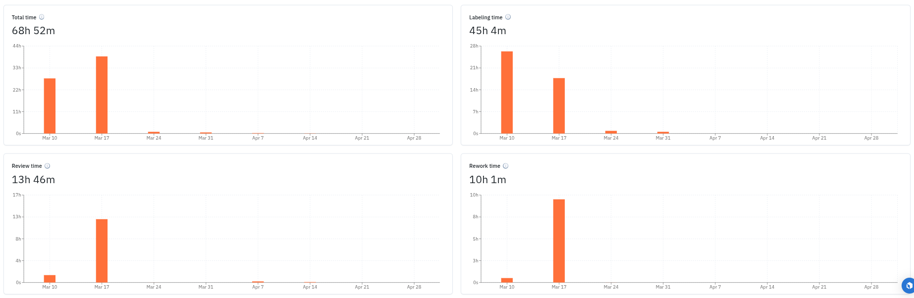
Task 2: Labeling and Preprocessing
Around 1k images were annotated
around 7 collaborators participated
Total annotation process took around 69h.

Slide 14
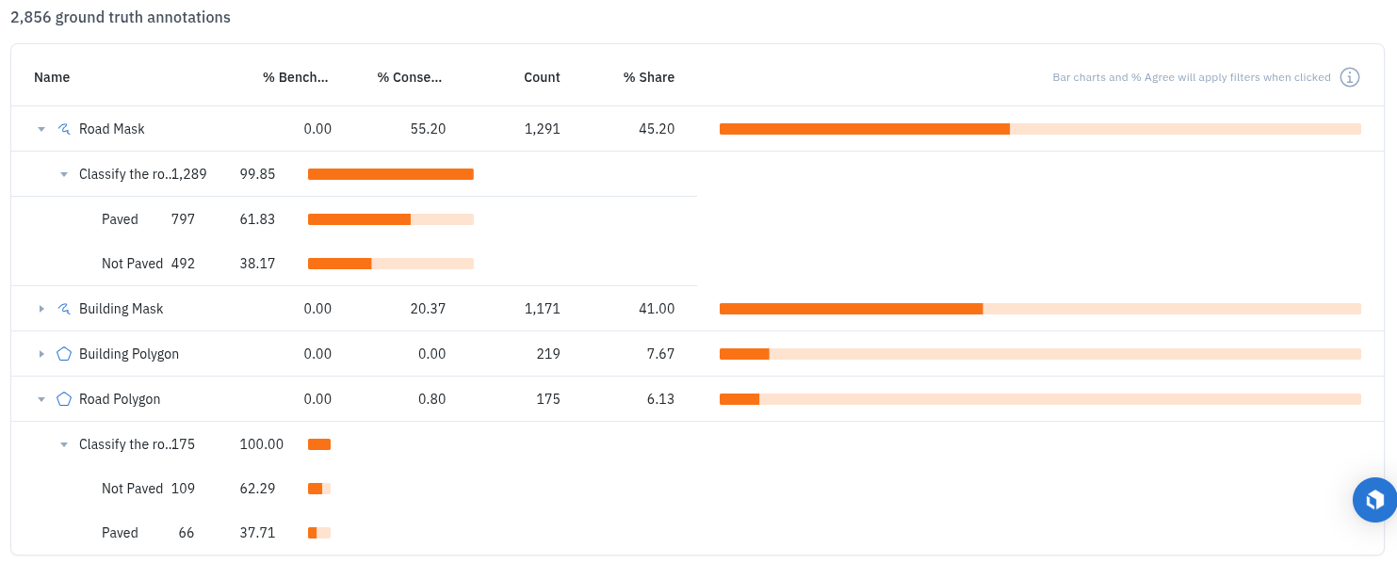
Task 2: Labeling and Preprocessing
Annotations - Roads

Slide 15
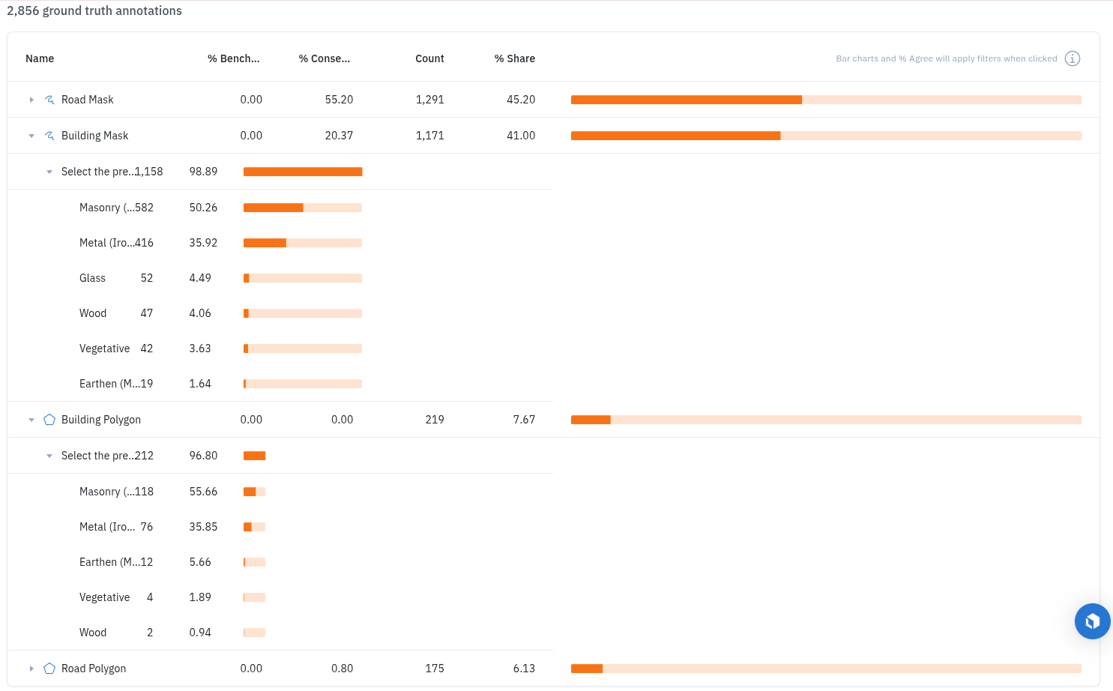
Task 2: Labeling and Preprocessing
Annotations - Buildings

Slide 16
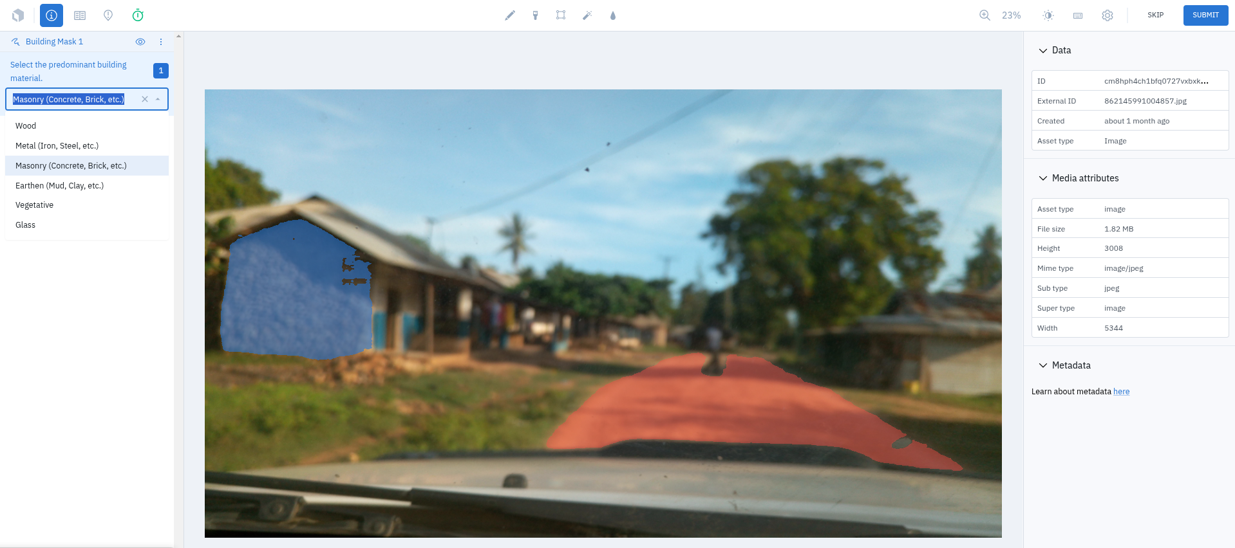
Annotation Example on Labelbox

Slide 17
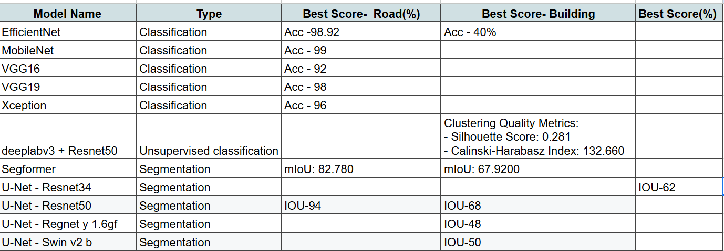
Task 3: Model Training

Slide 18
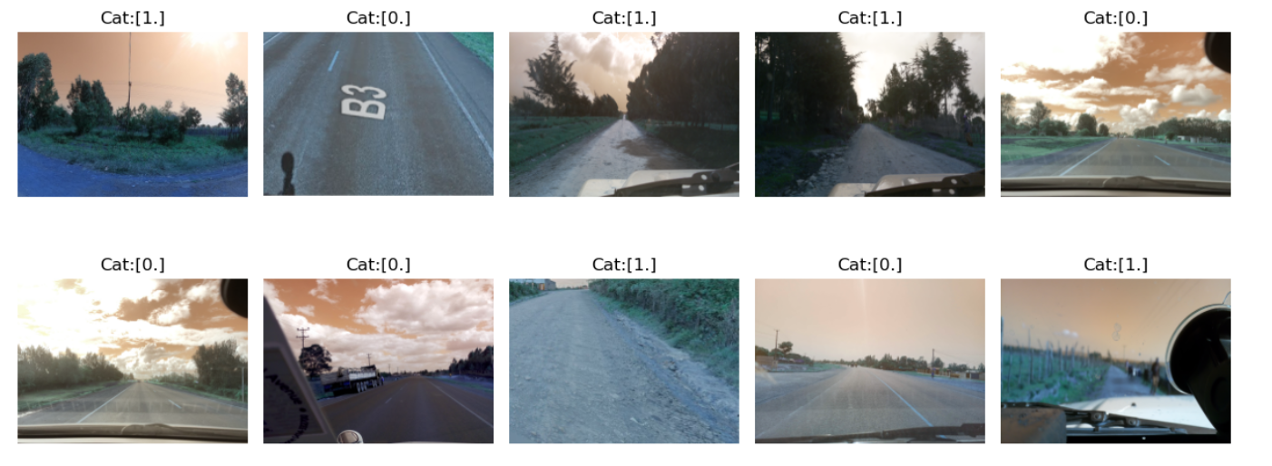
Task 3: Model Training
Examples
MobileNet

Slide 19
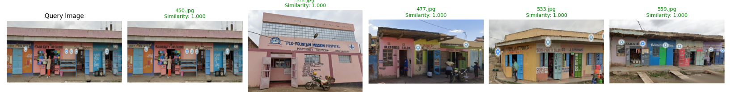
Task 3: Model Training
Examples
2. deeplabv3 + Resnet50

Slide 20
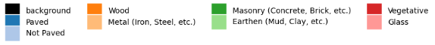
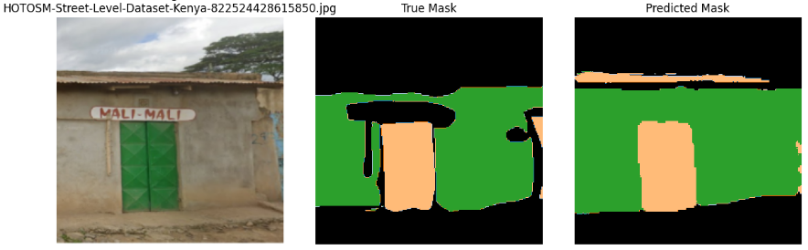
Task 3: Model Training
Examples
3. UNet

Slide 21
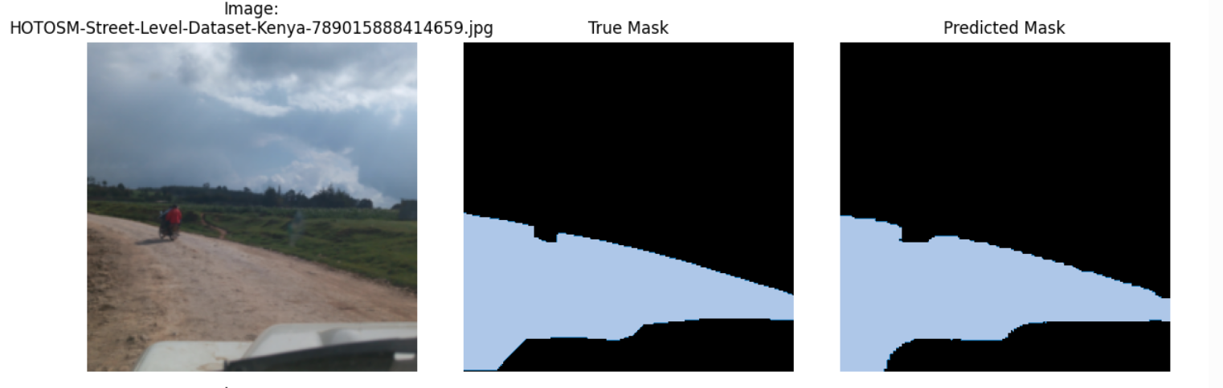
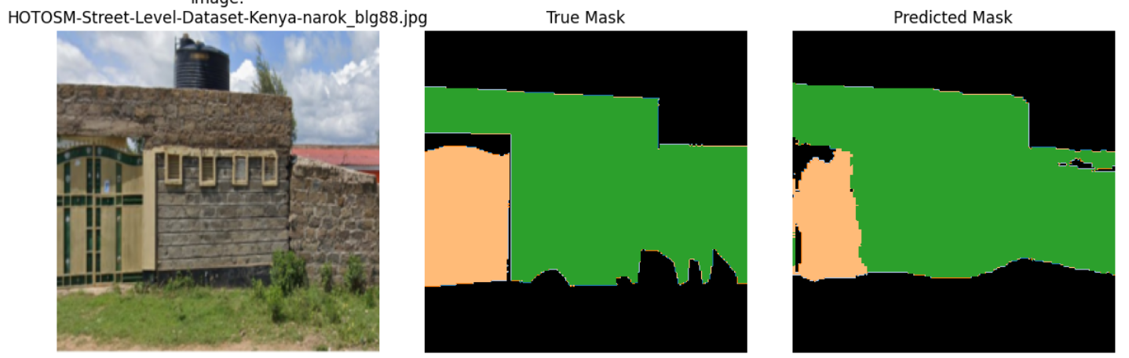

Slide 22
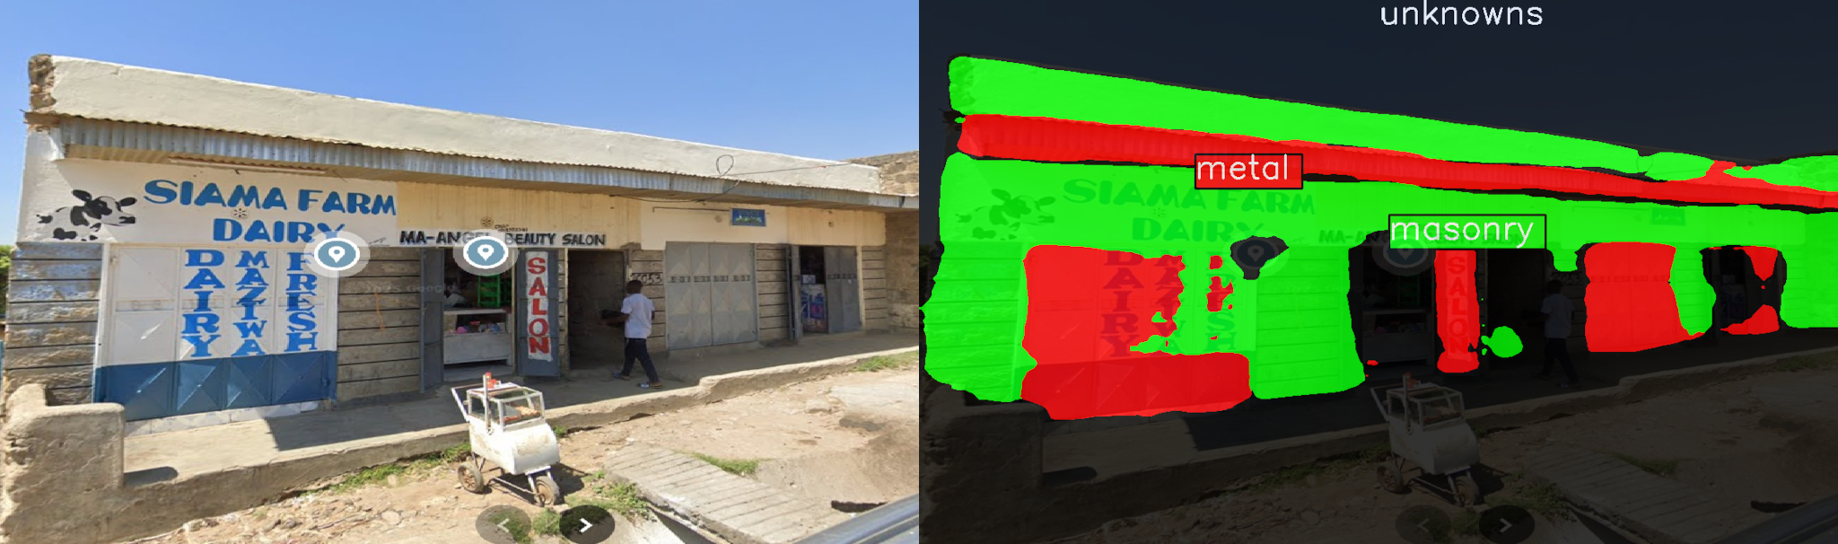
Task 3: Model Training
Examples
4. SegFormer

Slide 23
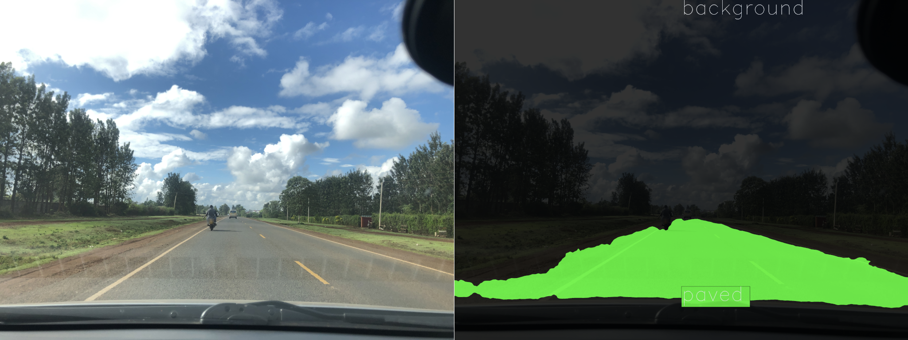
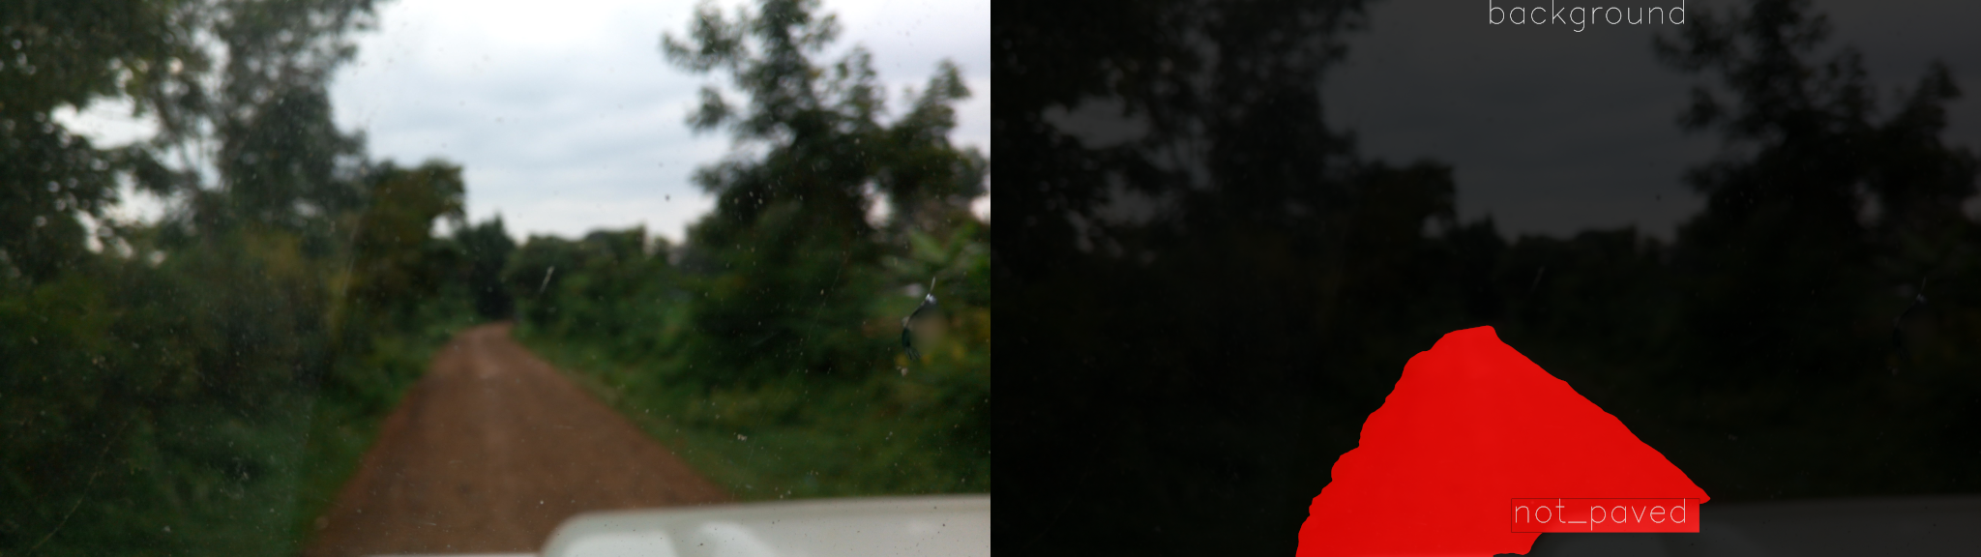
Task 3: Model Training
Examples

Slide 24
Opportunities identified
Road Models
Post-Disaster Road Damage Assessment: Analyze road conditions before and after disasters (e.g., floods, earthquakes) to prioritize emergency access and resource allocation.
Flood Risk Mitigation: Identify flood-prone roads to support proactive infrastructure upgrades and protect vulnerable communities.
Optimizing Aid Delivery: Improve routing for NGOs and agencies like the World Food Programme by identifying poor road conditions that hinder delivery.
Refugee Camp Accessibility: Map unpaved roads in conflict zones to ensure safer access for aid convoys and displaced populations.

Slide 25
Opportunities identified
Building Materials Models
Rapid Damage Assessment: Detect buildings made of vulnerable materials (e.g., mud, metal sheeting) to guide post-disaster reconstruction efforts.
Informal Settlement Mapping: Assess the materials used in informal settlements to evaluate safety and advocate for upgrades.
Fire Prevention: Flag settlements with flammable materials (e.g., plastic sheeting) to inform fire risk mitigation strategies.
Traditional Material Identification: Identify indigenous materials in historic neighborhoods to support preservation efforts.

Slide 26
Important Links
Github Links - OmdenaAI/HOTOSM-Street-Level
Images Links- images - Google Drive
Other -

Slide 27
Questions?
Thank You

